Slide 1
Transaction Manager
A transaction manager is a part of an application that controls the coordination of transactions over one or more resources.
The transaction manager is responsible for creating transaction objects and managing their durability and atomicity.

Slide 2

Transaction Concept
A transaction is a unit of program execution that accesses and possibly updates various data items.
E.g., transaction to transfer $50 from account A to account B:
1. read(A)
2. A := A – 50
3. write(A)
4. read(B)
5. B := B + 50
6. write(B)
Two main issues to deal with:
Failures of various kinds, such as hardware failures and system crashes
Concurrent execution of multiple transactions

Slide 3

Required Properties of a Transaction
Transaction to transfer $50 from account A to account B:
1. read(A)
2. A := A – 50
3. write(A)
4. read(B)
5. B := B + 50
6. write(B)
Atomicity requirement
If the transaction fails after step 3 and before step 6, money will be “lost” leading to an inconsistent database state
Failure could be due to software or hardware
The system should ensure that updates of a partially executed transaction are not reflected in the database
Durability requirement — once the user has been notified that the transaction has completed (i.e., the transfer of the $50 has taken place), the updates to the database by the transaction must persist even if there are software or hardware failures.

Slide 4
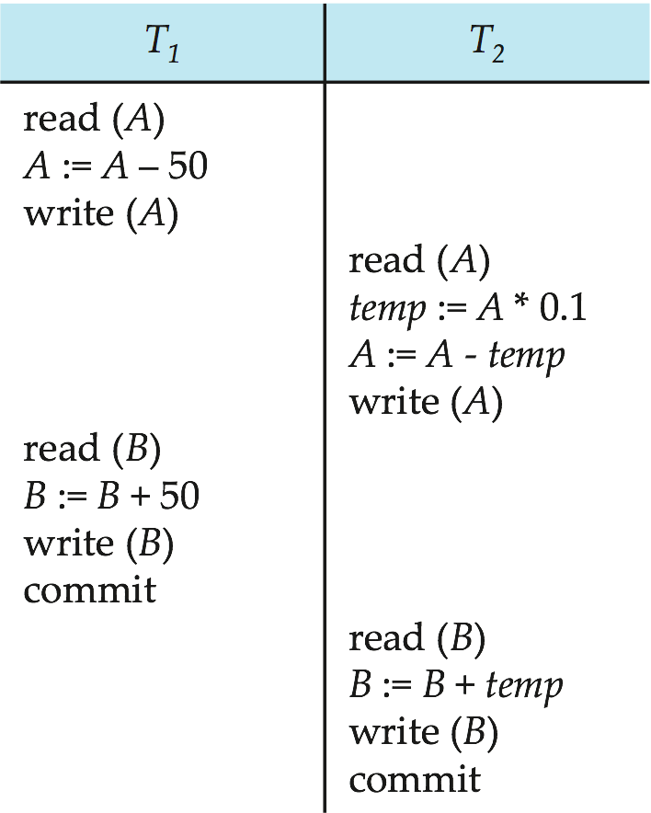

Required Properties of a Transaction (Cont.)
Consistency requirement in above example:
The sum of A and B is unchanged by the execution of the transaction
In general, consistency requirements include
Explicitly specified integrity constraints such as primary keys and foreign keys
Implicit integrity constraints
e.g., sum of balances of all accounts, minus sum of loan amounts must equal value of cash-in-hand
A transaction, when starting to execute, must see a consistent database.
During transaction execution the database may be temporarily inconsistent.
When the transaction completes successfully the database must be consistent
Erroneous transaction logic can lead to inconsistency

Slide 5

Required Properties of a Transaction (Cont.)
Isolation requirement — if between steps 3 and 6 (of the fund transfer transaction) , another transaction T2 is allowed to access the partially updated database, it will see an inconsistent database (the sum A + B will be less than it should be).
T1 T2
1. read(A)
2. A := A – 50
3. write(A) read(A), read(B), print(A+B)
4. read(B)
5. B := B + 50
6. write(B
Isolation can be ensured trivially by running transactions serially
That is, one after the other.
However, executing multiple transactions concurrently has significant benefits, as we will see later.

Slide 6

ACID Properties
A transaction is a unit of program execution that accesses and possibly updates various data items. To preserve the integrity of data the database system must ensure:
Atomicity. Either all operations of the transaction are properly reflected in the database or none are.
Consistency. Execution of a transaction in isolation preserves the consistency of the database.
Isolation. Although multiple transactions may execute concurrently, each transaction must be unaware of other concurrently executing transactions. Intermediate transaction results must be hidden from other concurrently executed transactions.
That is, for every pair of transactions T_{i} and T_{j}, it appears to T_{i} that either T_{j}, finished execution before T_{i} started, or T_{j} started execution after T_{i} finished.
Durability. After a transaction completes successfully, the changes it has made to the database persist, even if there are system failures.

Slide 7

Transaction State
Active – the initial state; the transaction stays in this state while it is executing
Partially committed – after the final statement has been executed. [just before “commit” –NT]
Failed -- after the discovery that normal execution can no longer proceed.
Aborted – after the transaction has been rolled back and the database restored to its state prior to the start of the transaction. Two options after it has been aborted:
Restart the transaction
can be done only if no internal logical error
Kill the transaction
Committed – after successful completion.

Slide 8
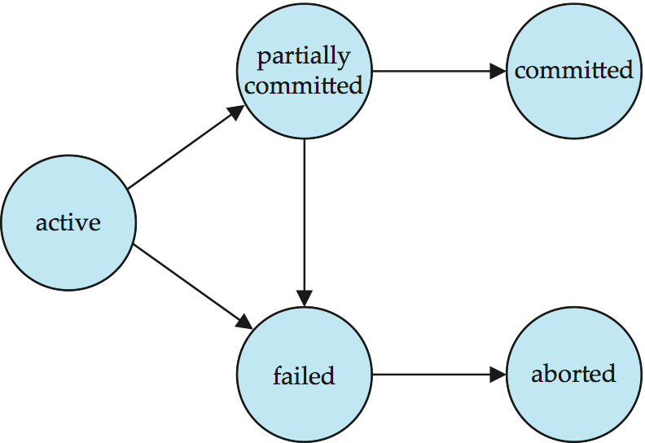
Transaction State (Cont.)

Slide 9

Concurrent Executions
Multiple transactions are allowed to run concurrently in the system. Advantages are:
Increased processor and disk utilization, leading to better transaction throughput
E.g. one transaction can be using the CPU while another is reading from or writing to the disk
Reduced average response time for transactions: short transactions need not wait behind long ones.
Concurrency control schemes – mechanisms to achieve isolation
That is, to control the interaction among the concurrent transactions in order to prevent them from destroying the consistency of the database
Will study in Chapter 15, after studying notion of correctness of concurrent executions.

Slide 10

Schedules
Schedule – a sequences of instructions that specify the chronological order in which instructions of concurrent transactions are executed
A schedule for a set of transactions must consist of all instructions of those transactions
Must preserve the order in which the instructions appear in each individual transaction.
A transaction that successfully completes its execution will have a commit instructions as the last statement
By default transaction assumed to execute commit instruction as its last step
A transaction that fails to successfully complete its execution will have an abort instruction as the last statement

Slide 11
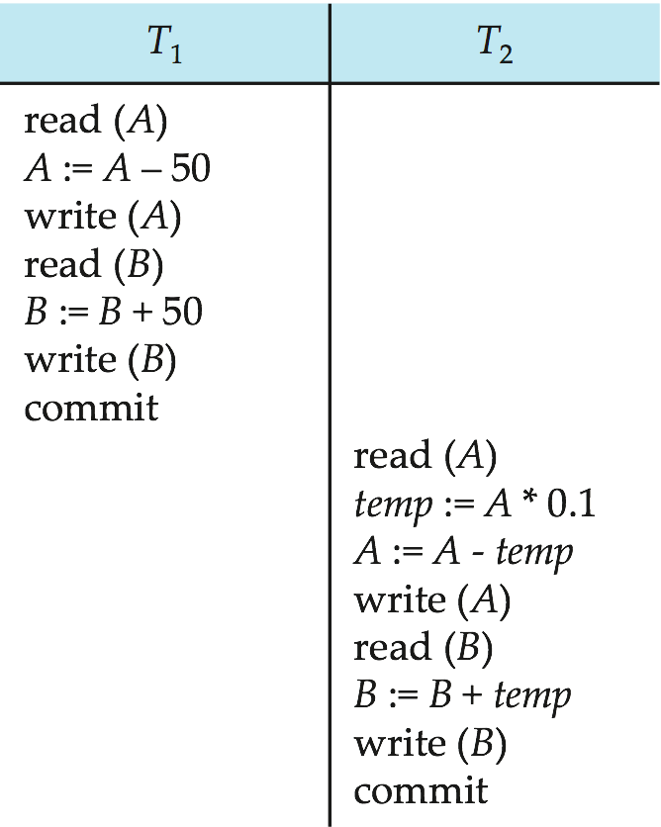
Schedule 1
Let T₁ transfer $50 from A to B, and T₂ transfer 10% of the balance from A to B.
An example of a serial schedule in which T₁ is followed by T₂ :
A =100, B=100, .In schedules 1, the sum “A + B” is preserved.

Slide 12
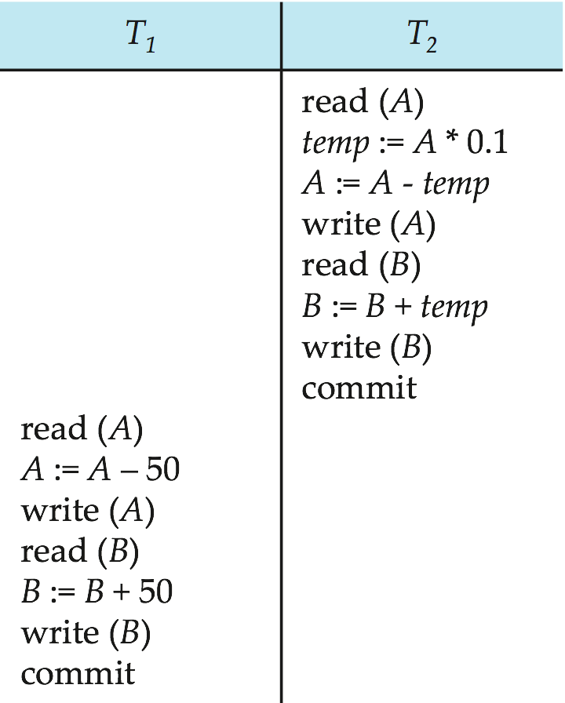
Schedule 2
A serial schedule in which T₂ is followed by T₁ :
A =100, B=100, .In schedules 2, the sum “A + B” is preserved.

Slide 13
Schedule 3
Let T₁ and T₂ be the transactions defined previously. The following schedule is not a serial schedule, but it is equivalent to Schedule 1.
Question Given A = 100 and B= 100. Prove that the above concurrent schedule preserve database consistency.

Slide 14
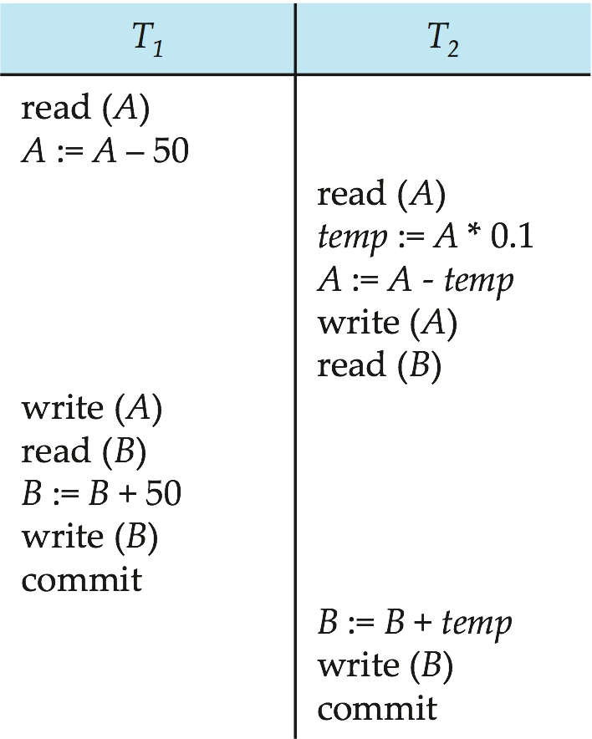
Schedule 4
The following concurrent schedule does not preserve the sum of “A + B”
Question Given A = 100 and B= 100. Prove that the above concurrent schedule does not preserve database consistency.

Slide 15
Serializability
Basic Assumption – Each transaction preserves database consistency.
Thus, serial execution of a set of transactions preserves database consistency.
A (possibly concurrent) schedule is serializable if it is equivalent to a serial schedule. Different forms of schedule equivalence give rise to the notions of:
1. conflict serializability
2. view serializability

Slide 16
Simplified view of transactions
We ignore operations other than read and write instructions
We assume that transactions may perform arbitrary computations on data in local buffers in between reads and writes.
Our simplified schedules consist of only read and write instructions.

Slide 17

Conflicting Instructions
Let l_{i} and l_{j} be two Instructions of transactions T_{i} and T_{j} respectively. Instructions l_{i} and l_{j} conflict if and only if there exists some item Q accessed by both l_{i} and l_{j}, and at least one of these instructions wrote Q.
1. l_{i} = read(Q), l_{j} = read(Q). l_{i} and l_{j} don’t conflict. 2. l_{i} = read(Q), l_{j} = write(Q). They conflict. 3. l_{i} = write(Q), l_{j} = read(Q). They conflict 4. l_{i} = write(Q), l_{j} = write(Q). They conflict
Intuitively, a conflict between l_{i} and l_{j} forces a (logical) temporal order between them.
If l_{i} and l_{j} are consecutive in a schedule and they do not conflict, their results would remain the same even if they had been interchanged in the schedule.

Slide 18
Conflict Serializability
If a schedule S can be transformed into a schedule S´ by a series of swaps of non-conflicting instructions, we say that S and S´ are conflict equivalent.
We say that a schedule S is conflict serializable if it is conflict equivalent to a serial schedule

Slide 19
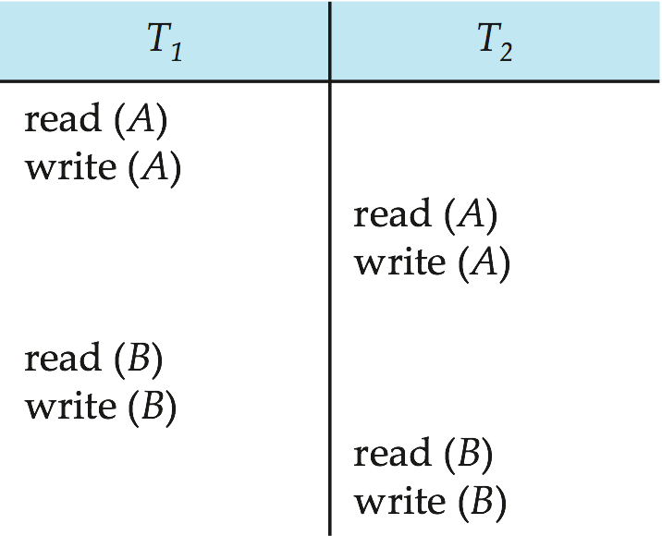
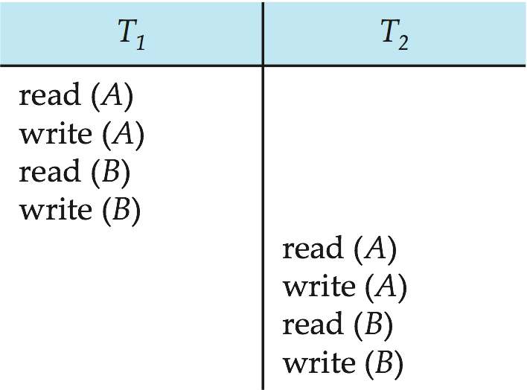
Conflict Serializability (Cont.)
Schedule 3 can be transformed into Schedule 6 -- a serial schedule where T₂ follows T₁, by a series of swaps of non-conflicting instructions. Therefore, Schedule 3 is conflict serializable.
Schedule 3
Schedule 6

Slide 20
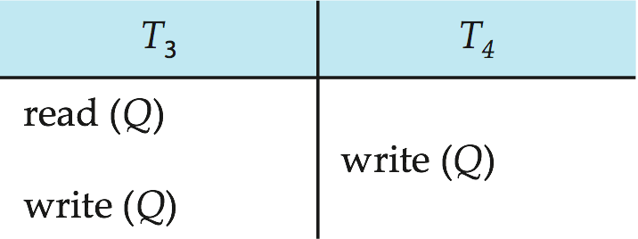
Conflict Serializability (Cont.)
Example of a schedule that is not conflict serializable:
We are unable to swap instructions in the above schedule to obtain either the serial schedule < T₃, T₄ >, or the serial schedule < T₄, T₃ >.

Slide 21
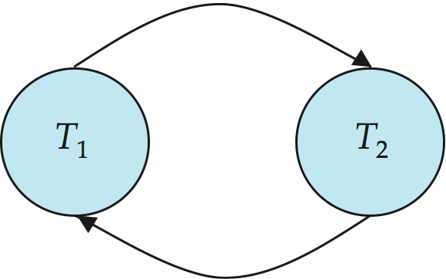
Precedence Graph
Consider some schedule of a set of transactions T₁, T₂, ..., T_{n}
Precedence graph — a direct graph where the vertices are the transactions (names).
We draw an arc from T_{i} to T_{j} if the two transaction conflict, and T_{i} accessed the data item on which the conflict arose earlier.
We may label the arc by the item that was accessed.
Example

Slide 22
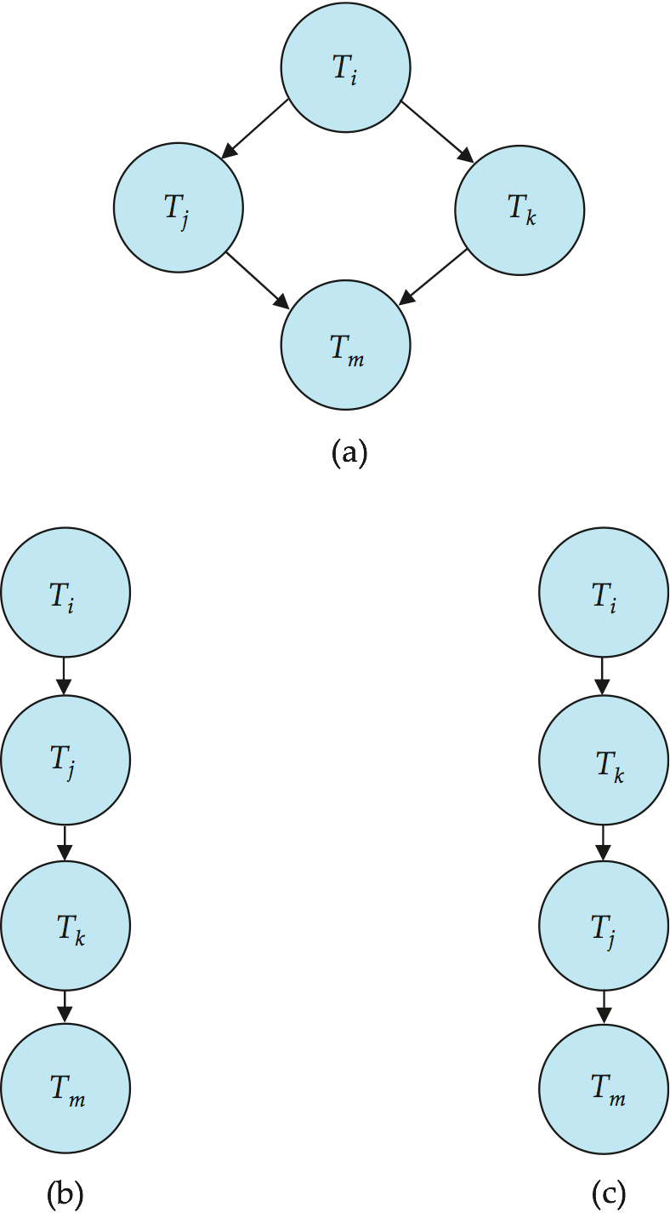

Testing for Conflict Serializability
A schedule is conflict serializable if and only if its precedence graph is acyclic.
Cycle-detection algorithms exist which take order n² time, where n is the number of vertices in the graph.
(Better algorithms take order n + e where e is the number of edges.)
If precedence graph is acyclic, the serializability order can be obtained by a topological sorting of the graph.
That is, a linear order consistent with the partial order of the graph.
For example, a serializability order for the schedule (a) would be one of either (b) or (c)

